Slide 1


Slide 2

Customer Satisfaction
Is Our Highest Priority

Slide 3


Slide 4
In this session
Achieved
What we are learning in this session
Introduction
Data Types and Variables
Operators
www.bacancytechnology.com

Slide 5
Let’s Start

Slide 6
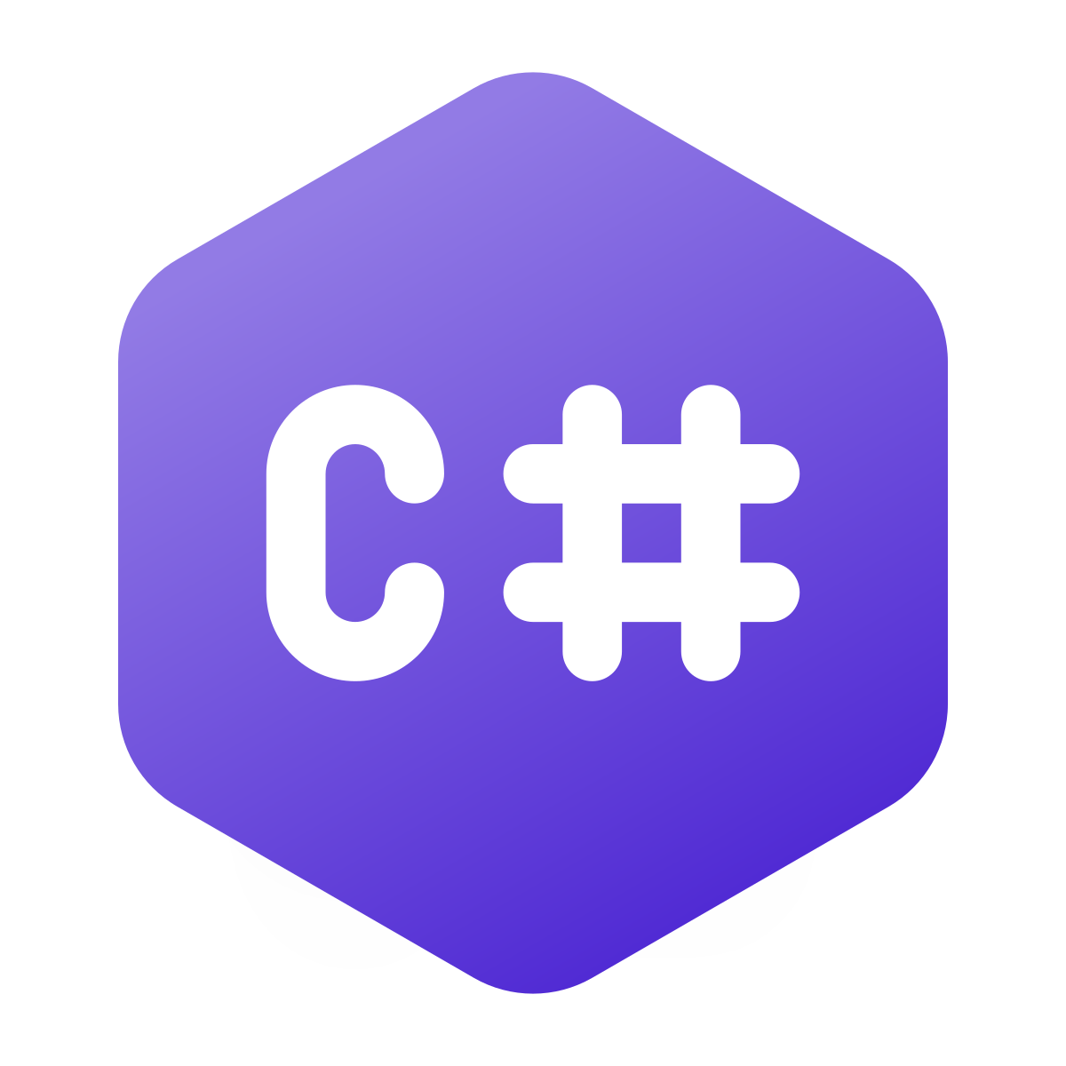
Introduction

Slide 7
Introduction
Achieved
What is C#?
C# is pronounced "C-Sharp".
It is an object-oriented programming language created by Microsoft that runs on the .NET Framework.
C# has roots from the C family, and the language is close to other popular languages like C++ and Java.
The first version was released in year 2002. The latest version, C# 13, was released in November 2024.
C# is used for:
Mobile applications, Desktop applications, Web applications, Web services, Web sites, Games, VR, Database applications, And much, much more!
www.bacancytechnology.com
Notes:
https://www.geeksforgeeks.org/introduction-to-c-sharp/

Slide 8
Introduction
Achieved
Why Use C#?
It is one of the most popular programming language in the world.
It is easy to learn and simple to use.
It has a huge community support.
C# is an object oriented language which gives a clear structure to programs and allows code to be reused, lowering development costs.
As C# is close to C, C++ and Java, it makes it easy for programmers to switch to C# or vice versa.
www.bacancytechnology.com

Slide 9
Variable and Data Type
Achieved
What is a Variable?
A variable is like a storage box where you can keep data. Each variable has:
Name: So you can refer to it (e.g., age, name).
Data Type: So the computer knows what kind of data it will store (e.g., a number, a letter, or a true/false value).
Value: The actual data you put into the box (e.g., 25 for age).
What is a Data Type?
Data type tells the computer what kind of data a variable will store. In C#, you must specify this when you create a variable. It ensures the variable behaves correctly (e.g., numbers can be added, and strings can be combined).
www.bacancytechnology.com

Slide 10
Variable and Data Type
Achieved
Allowed in Variable Names
You can start the name with a letter(a-z, A-Z).
You can use numbers in the name, but not as the first character.
You can use underscores in the name, and it can even be the first character.
C# is case-sensitive, so myVariable and MyVariable are different variables.
Not Allowed in Variable Names
Variable names cannot contain spaces. Use camelCase or underscores instead.
Variable names cannot begin with a number.
You cannot use special characters like @, #, $, %, ^, &, *, etc.
C# has certain reserved keywords (e.g., int, class, namespace, etc.) that you cannot use as variable names directly.
Hyphens are not allowed in variable names. Use underscores instead.
www.bacancytechnology.com

Slide 11
Data Type
Achieved
C# Data Type | Range | Size | .NET Type | Notes
byte | 0 to 255 | 1 byte | System.Byte | For small positive numbers.
sbyte | -128 to 127 | 1 byte | System.SByte | For small signed integers.
short | -32,768 to 32,767 | 2 bytes | System.Int16 | For small integers.
ushort | 0 to 65,535 | 2 bytes | System.UInt16 | For small positive integers.
int | -2,147,483,648 to 2,147,483,647 | 4 bytes | System.Int32 | Most commonly used for whole numbers.
uint | 0 to 4,294,967,295 | 4 bytes | System.UInt32 | For large positive numbers.
long | -9,223,372,036,854,775,808 to 9,223,372,036,854,775,807 | 8 bytes | System.Int64 | For very large integers.
www.bacancytechnology.com

Slide 12
Data Type
Achieved
C# Data Type | Range | Size | .NET Type | Notes
ulong | 0 to 18,446,744,073,709,551,615 | 8 bytes | System.UInt64 | For very large positive numbers.
float | ±1.5 × 10⁻⁴⁵ to ±3.4 × 10³⁸ | 4 bytes | System.Single | For floating-point numbers. Use f suffix (e.g., 3.14f).
double | ±5.0 × 10⁻³²⁴ to ±1.7 × 10³⁰⁸ | 8 bytes | System.Double | More precise than float. Default for decimal numbers.
decimal | ±1.0 × 10⁻²⁸ to ±7.9 × 10²⁸ | 16 bytes | System.Decimal | Best for financial or monetary calculations. Use m suffix (e.g., 12.99m).
char | Any single Unicode character | 2 bytes | System.Char | Use single quotes (e.g., 'A').
bool | true or false | 1 byte | System.Boolean | For logical operations.
www.bacancytechnology.com

Slide 13
Nullable Types
Achieved
Nullable Types in C#
In C#, nullable types allow variables of value types (like int, double, bool, etc.) to hold a special value called null.
Why Use Nullable Types?
A database query may return null for an empty field.
A variable that hasn't been assigned a value yet might need to signify "no value."
How to Declare a Nullable Type
int? age = null; // Nullable integer
Nullable<int> age = null; // Equivalent to int?
www.bacancytechnology.com

Slide 14

readonly and const
Achieved
const
A constant is a value that is known at compile-time and never changes.
It must be initialized when declared.
It is implicitly static, meaning it belongs to the type (class/struct) rather than any instance.
const data_type field_name = value;
readonly
A readonly field can only be assigned once, either:
At the time of declaration.
Or, in the constructor (for instance fields).
readonly data_type field_name;
const
readonly
required
www.bacancytechnology.com

Slide 15
Operators
Achieved
Arithmetic Operators
Addition (+), Subtraction (-), Multiplication (*), Division (/), Modulus (%)
Why Use Arithmetic Types?
Arithmetic operators used to perform mathematical operations on numbers.
Example
Addition (+), Subtraction (-), Multiplication (*), Division (/), Modulus (%)
Examples: a + b, a * b
www.bacancytechnology.com
www.bacancytechnology.com

Slide 16
Operators
Achieved
Logical Operators
AND (&&), OR (||), NOT (!)
Why Use Logical Types?
Logical operators are used for checking conditions
Example
Examples: a && b, !a
www.bacancytechnology.com
www.bacancytechnology.com

Slide 17
Operators
Achieved
Assignment Operators
AND (&&), OR (||), NOT (!)
Why Use Assignment Types?
Basic Assignment (=): a = 5
Compound Assignments: Add and Assign (+=), Subtract and Assign (-=), Multiply and Assign (*=), etc.
Example
Examples: a += 5, b *= 2
www.bacancytechnology.com
www.bacancytechnology.com

Slide 18
Thank you

